Slide 1


Financial Modeling Made Easy 4.0
This presentation is geared towards startups looking for VC funding. We will explore my experiences of 14 years working as a management consultant and fractional CFO for early stage firms.
Facilitator: Andrew Wood
1

Slide 2
The only bad questions are the ones that are not asked! Speak up, raise your hand at any time, I can bring things back on track.
Agenda
Theory
  What is a Financial Model?
  Mental Traps & The Founder’s Dilemma
  Financial Model Fallacies
  4 Economic Drivers of a Model
  Modeling Best Practices
AI Considerations
The mini model – only for display purposes

Slide 3
Financial Modeling 101
A business simulation using inputs to forecast a firm's financial performance.
In the VC world it is used to gauge the exit value.
Most commonly built in Excel or G-Sheets.
May have all 3 financial statements which are fed from assumption schedules.
The Financial Model is only one Deliverable of your pitch, do not get stuck.

Slide 4
Fundraising Deliverables & Let’s Get Perspective
Successful entrepreneurs spend the majority of their time on value building activities.

Slide 5
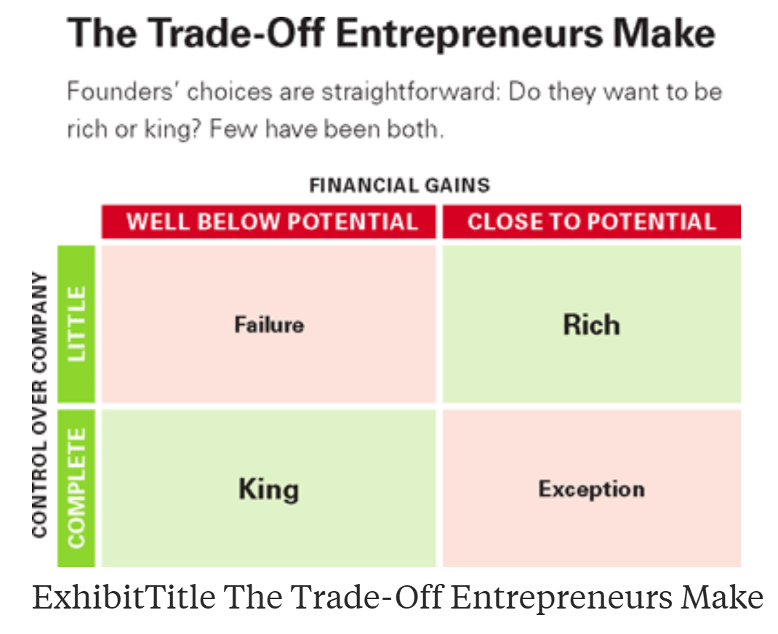
Financial Models Can Create Alignment on Teams
The Founder’s Dilema by Noam Wasserman
In order to achieve a steeper Revenue Curve sooner, you will have a deeper valley in the Cash curve, which implies burning more cash, raising more and giving up more equity which implies a higher valuation and better exit for all – in theory

Slide 6
Fallacies of Financial Modeling – NOT TRUE
NOT TRUE:
I need to be an Excel Ninja to create a financial model
Financial models generate value (sales and client feedback)
Eventually the model will be done and everyone will like it
Financial Models are good predictors for the future

Slide 7
Choose Simplicity over Complexity in your use of Formulae
The way you read a book – left to right and top to bottom
Keep formatting the same periods in the same column across Sheets
Use industry appropriate verbiage & labels and use consistently
Avoid modeling the wind direction
Maintain the same level of depth across your assumptions
Keep your actuals Separate to start
Understand your Working Capital – Timing of Cash
Has there ever been another company to achieve your projections
Bottom Up Approach – build from details “Drivers”
10 BEST PRACTICES

Slide 8
The 4 Components of your Financial/Economic Model
Volume
Margin
Operating Leverage
Revenue Drivers
How many different revenue lines do I have?
How much are fixed costs in relation to variable costs?
How much money is left after I sell something and you subtract its unit costs/variable cost?
How many Units am I going to sell?
All these questions answer the question: “How will I capture value?”

Slide 9
Skill on Github for Download - MVP
Using AI - Precautions
Bad prompts create bad results
Do not upload sensitive data
You are now armed and dangerous
AI takes away the safety and makes it full automatic
Ask AI to be critical and share opposing views
It is always going to be your model, not the consultants or Ai’s, the errors in it are yours.
A Claude AI skill that builds a complete 60-month, 3-statement financial model (Income Statement, Balance Sheet, Cash Flow) through an interactive conversation with the founder.
https://github.com/wcg-cloudcode/startupmaine-financial-model-skill
TERMS OF USE
1. VIEWING AND EVALUATION
You may view, download, and evaluate this skill and its accompanying files for personal, non-commercial evaluation purposes only.
2. COMMERCIAL USE REQUIRES A LICENSE
Any commercial use — including but not limited to using this skill to build financial models for clients, incorporating it into paid products or services, or redistributing it as part of a commercial offering — requires a written license from Wood Consulting Group.
3. MODIFICATION
You may modify the skill for personal evaluation purposes. Modified versions may not be distributed without written permission.
4. REDISTRIBUTION
You may not redistribute this skill, in whole or in part, modified or unmodified, without written permission from Wood Consulting Group.
5. ATTRIBUTION
Any permitted use must include clear attribution to Wood Consulting Group and a link to the original repository.
6. NO WARRANTY
THIS SKILL IS PROVIDED "AS IS" WITHOUT WARRANTY OF ANY KIND, EXPRESS OR IMPLIED. IN NO EVENT SHALL THE AUTHOR BE LIABLE FOR ANY CLAIM, DAMAGES, OR OTHER LIABILITY ARISING FROM THE USE OF THIS SKILL OR ITS OUTPUTS.
For licensing inquiries, contact: andrew@woodcg.com
What I ask in return is a linkedin shout out, review and /or a conversation.

Slide 10
Financial models do not generate value
Every Financial model ever created was wrong
Demonstrate conservatism without saying it - under promise and over deliver
The only valuation that matters is the exit value
Simplicity over Complexity Prevails
You must know your model
Key Takeaways

Slide 11

Contact
Let’s get Modeling!
Contact us
Andrew@woodcg.com
207.956.1484
11

